Slide 1

Digital Electronics and Computer Architecture
SCHOOL OF COMPUTER SCIENCE AND ENGINEERING

Slide 2

Digital Electronics and Computer Architecture
Examination scheme: Total Marks-150
- 60 Marks Class Continuous Assessment
- 50 Marks Laboratory Continuous Assessment
- 40 Marks End Examination

Slide 3

Digital Electronics and Computer Architecture
Course Objectives:
By participating in and understanding all facets of this Course a student will be able:
To learn number systems, Boolean algebra and to introduce the concepts of digital logic families.
To develop skills for design and implementation of combinational logic circuits.
To develop skills for design and implementation of sequential circuits
To understand the functions, characteristics of various components of computer, instruction set, addressing mode of computer architecture and Pipeline Hazards
To acquire the knowledge of Control unit architecture and Memory Organization

Slide 4
Digital Electronics and Computer Architecture
Course Outcomes:
On completion of course, students will be able to
Identify and use the basic logic gates and solve logic equations with various reduction techniques of digital logic circuits.
Design and implement combinational logic circuits
Design and implement sequential logic circuits
Recognize the functions and organization of various blocks of CPU. Describe CPU instruction characteristics used in Pipelining concept and its relevance with Processor’s performance.
Demonstrate computer architecture concepts related control unit and memory

Slide 5
Syllabus
Module 1 Computer Arithmetic:
Introduction to digital logic families, Introduction to Number System and Codes, Sign Magnitude representation, 1’s and 2’s complement, Binary Arithmetic: Addition, Subtraction of signed numbers, multiplication of positive numbers, Integer Arithmetic, Floating point representation and operations – IEEE standard, Boolean Algebra, Logic Gates, Minimization of logic functions using K map (SOP and POS)
Module 2 Combinational Logic Design:
Design examples: Arithmetic circuits, Comparator, Code converters, Parity generators and checkers, Arithmetic and Logic Unit, design of adder and fast adder, look ahead carry generator, Implementation of SOP and POS using MUX, DMUX, DECODER.
Module 3 Sequential Logic Design:
1-bit Memory Cell, Flip flops, Conversion of flip flops, Design of ripple counters and synchronous counters, Modulus of the counter, Sequence generator, Lock out condition. Shift registers, Applications of Shift registers (ring and twisted ring counters), Moore and Mealy Models- State diagram, State Tables and Design Procedure, Sequence detector.

Slide 6
Syllabus
Module 4 Fundamental of Computer Architectures:
Structure and Function, basic operational concepts of bus structures Memory locations and addresses functions. Types of computer units (CPU, Memory, I/O, System Bus), Von Neumann & Harvard architecture, Key characteristics of RISC & CISC.
ALU: Multiplication – Block diagram, Hardware implementation of unsigned binary and signed number, Booth’s Algorithm, Division Algorithms (Unsigned Binary).
Processor organization, Register organization- user visible registers, control and status registers-Case Study 8086. Instruction Cycle- The machine cycle and Data flow. Types of operands, Types of operations, Types of instructions, Addressing modes and Instruction Formats- instruction length, allocation of bits, variable length instructions instruction formats - Case Study- 8086. Processor and Instruction Pipelining, Pipeline Performance, Pipeline Hazards - Structural, Data, Control.

Slide 7
Syllabus
Module 5 Control Unit and Memory System:
Hardwired control, Micro-programmed control- micro instructions, micro-program sequencing, wide branch addressing, microinstruction with next address field, prefetching microinstructions and emulation.
Memory hierarchy, characteristics, Cache Memory- Cache memory principles, Elements of cache design- cache address, size, mapping functions, replacement algorithms, write policy, line size, number of cache, one level and two level cache, performance characteristics of two level cache- locality & operations, main memory and secondary storage. Pentium IV cache organization

Slide 8
Syllabus
List of Assignments:
Design and Implement Code Converters using logic gates
Design and Implement Combinational Logic Design using MUX/Decoder ICs
Design and Implement asynchronous counter using JK- Flip flop.
Design and Implement MOD-N asynchronous counter using JK- Flip flop /IC7490.
Design and implement Synchronous Counter
Design of a sequence detector
Write an assembly language program (ALP) to display 2-digit and 4-digit hex numbers using 64- bit assembly language programming
Write an assembly language program (ALP) to accept 2-digit and 4-digit hex numbers user input using 64- bit assembly language programming.
Write an assembly language program (ALP) to implement addition and subtraction of 8-bit numbers (Using user input, macro and procedure).
Write an ALP to perform basic string operations. (length and Reverse)

Slide 9
Fundamental of Computer Architectures
Computer has two important terminologies associated with it.
Computer Architecture
Computer Organization
Computer Architecture:
Describes features of a computer family (notably the instructions) and not the specific implementation, just like architecture of a house- Instruction set, Addressing types.
Computer Organization:
The internal arrangement of computer, which includes the design of the processor, memory and input/output circuits.

Slide 10
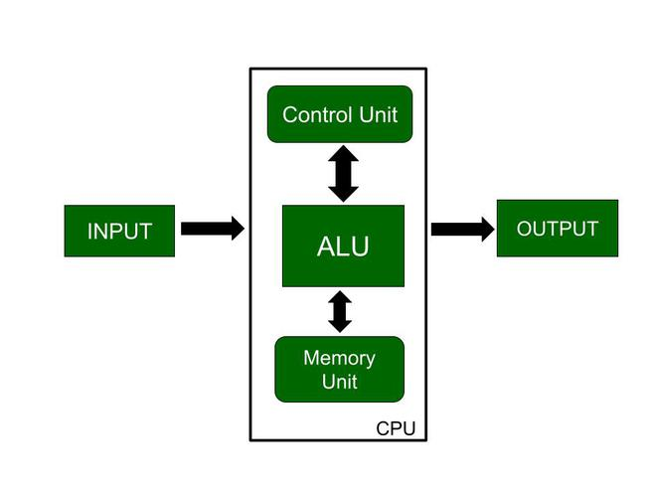
Fundamental of Computer Architectures

Slide 11
Fundamental of Computer Architectures
Structure & Function:
Structure: is the way in which components relate to each other. (interrelated)
Function: is the operation of individual components as part of the structure.

Slide 12
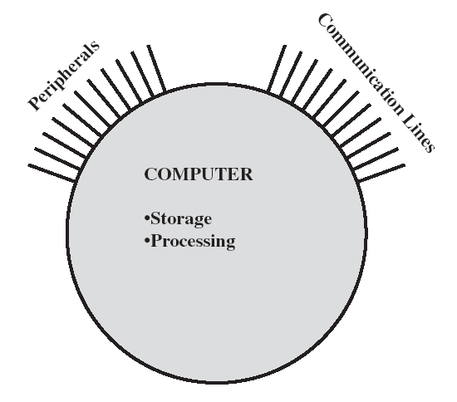
Computer Structure
Two methods are used in specifying Computer Structure
Top-Down and Down-Top.
Computer as a Structure includes basic building blocks as:
CPU: Controls the operation of the computer and performs its data processing functions.
Main memory: Stores data
I/O: Moves data between the computer and its external environment
System interconnection: Provided for communication among CPU, main memory, and I/O.

Slide 13
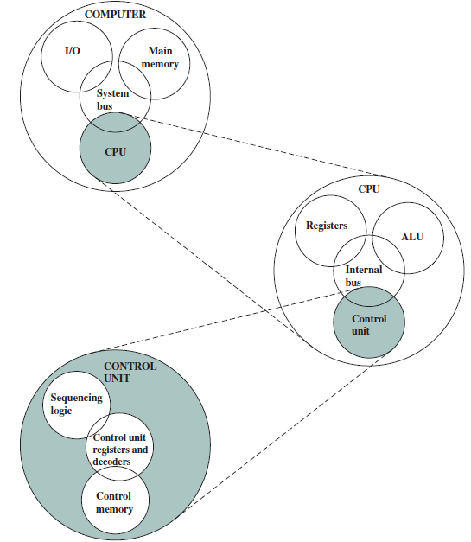
The Computer: Top Down Structure

Slide 14
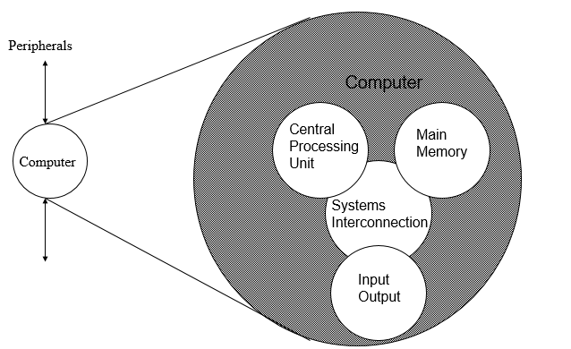
Structure - Top Level

Slide 15
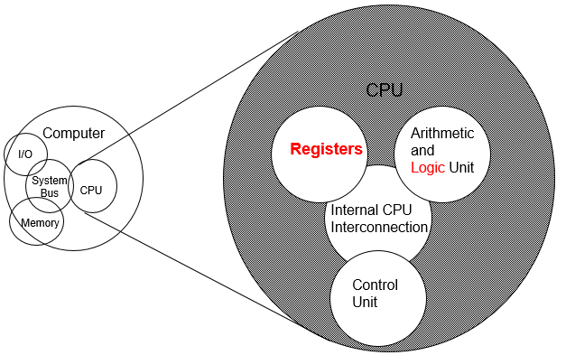
Structure - ALU

Slide 16
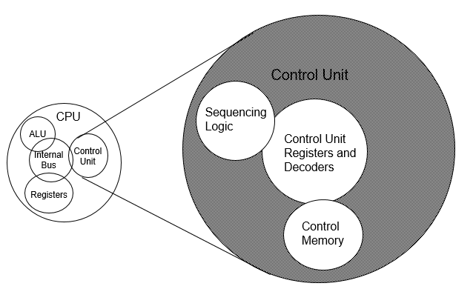
Structure – Control Unit

Slide 17
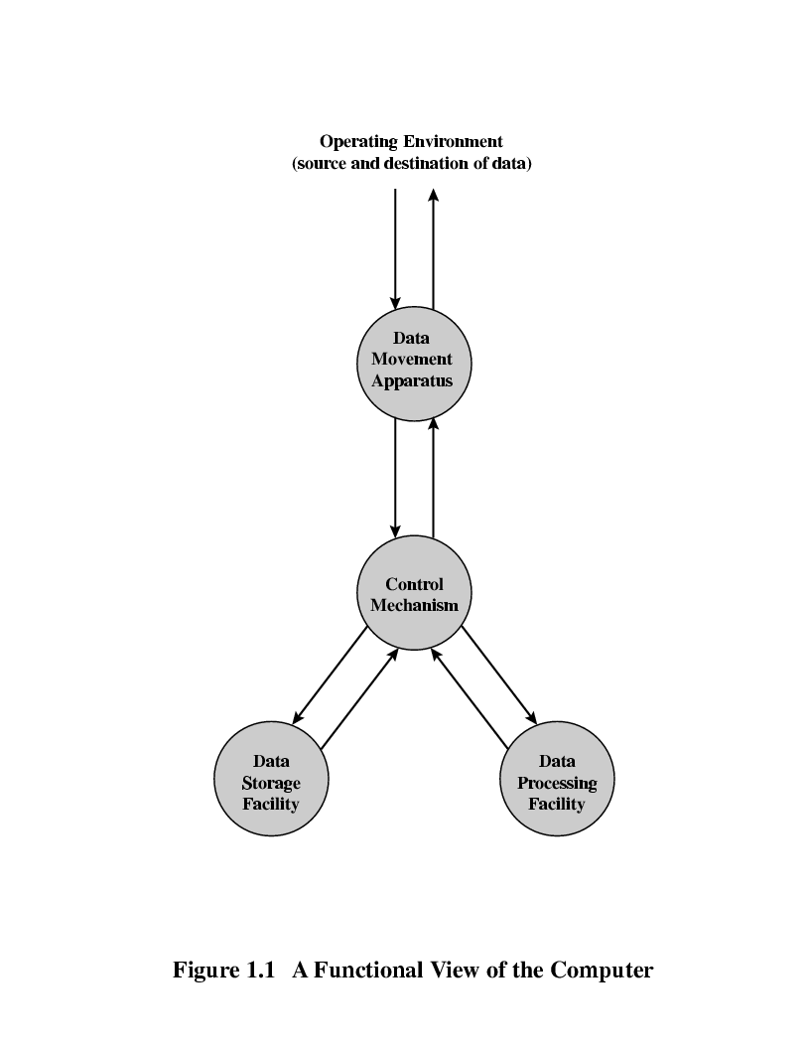
Computer functions
Computer functions are:
Data movement
Data storage
Data processing
Control

Slide 18
Computer functions
Computer functions are:
Data movement
Data storage
Data processing
Control

Slide 19
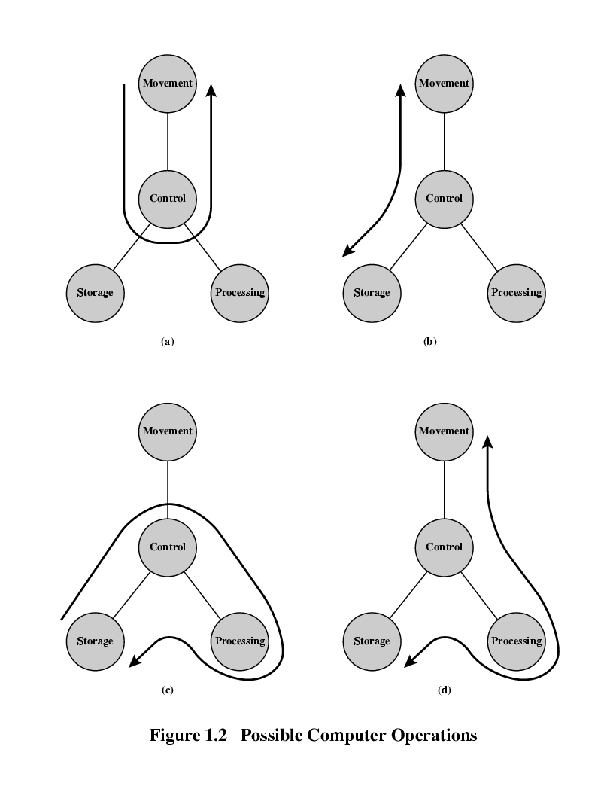
Data Movement
Data movement:
The computer’s operating environment consists of devices that serve as either sources or destinations of data.
When data are received from or delivered to a device that is directly connected to the computer, the process is known as input–output (I/O), and the device is referred to as a peripheral.
When data are moved over longer distances, to or from a remote device, the process is known as data communications.

Slide 20
Storage (Read or Write)
Even if the computer is processing data on the fly (i.e., data come in and get processed, and the results go out immediately), the computer must temporarily store at least those pieces of data that are being worked on at any given moment.
Thus, there is at least a short-term data storage function. Equally important, the computer performs a long- term data storage function.
Files of data are stored on the computer for subsequent retrieval and update. SUB AL,BL

Slide 21
Processing Function
Processing from/to storage
Processing from storage to I/O

Slide 22
Functions
Data processing: Data may take a wide variety of forms, and the range of processing requirements is broad.
2. Data storage: Even if the computer is processing data on the fly , the computer must temporarily store thus, there is at least a short-term data storage function. Equally important, the computer performs a long- term data storage function. Files of data are stored on the computer for subsequent retrieval and update.
3. Data movement: The computer’s operating environment consists of devices that serve as either sources or destinations of data. When data are received from or delivered to a device that is directly connected to the computer, the process is known as input–output (I/O), and the device is referred to as a peripheral. When data are moved over longer distances, to or from a remote device, the process is known as data communications.
4. Control: Within the computer, a control unit manages the computer’s resources and orchestrates (coordinates) the performance of its functional parts in response to instructions.

Slide 23
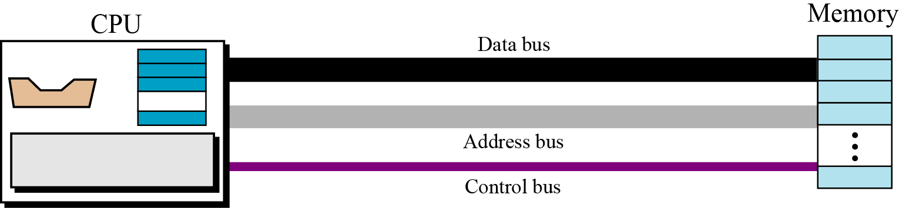
Bus Structure
The CPU and memory are normally connected by three groups of connections, each called a bus: data bus, address bus and control bus
Connecting CPU and memory using three buses

Slide 24
Bus Structure
Group of wires which carries information form CPU to peripherals or vice – versa
Single bus structure: Common bus used to communicate between peripherals and microprocessor
INPUT
MEMORY
PROCESSOR
OUTPUT
SINGLE BUS STRUCTURE

Slide 25
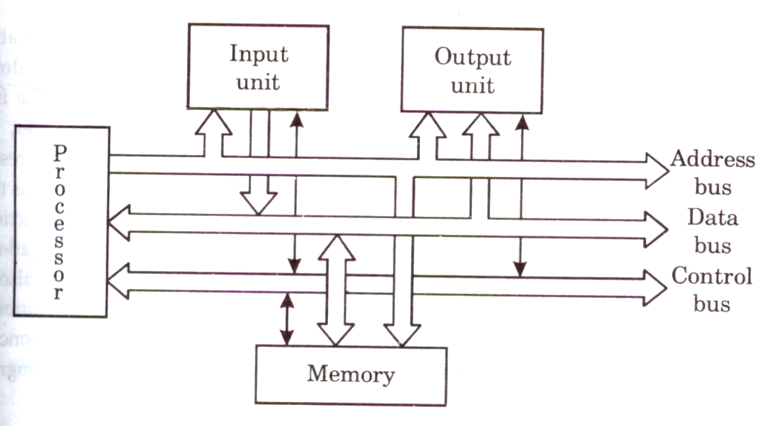
Bus Structure
To improve performance multi-bus structure can be used
In two – bus structure : One bus can be used to fetch instruction other can be used to fetch data, required for execution.
Thus improving the performance ,but cost increases

Slide 26
Bus Structure
Address bus : unidirectional : group of wires which carries address information bits form processor to peripherals (16,20,24 or more parallel signal lines)
Data bus: bidirectional : group of wires which carries data information bit form processor to peripherals and vice – versa
Control bus: bidirectional: group of wires which carries control signals form processor to peripherals and vice – versa

Slide 27
Memory Locations and Addresses
Main memory is the second major subsystem in a computer. It consists of a collection of storage locations, each with a unique identifier, called an address.
Data is transferred to and from memory in groups of bits called words. A word can be a group of 8 bits, 16 bits, 32 bits or 64 bits (and growing).
If the word is 8 bits, it is referred to as a byte. The term “byte” is so common in computer science that sometimes a 16-bit word is referred to as a 2-byte word, or a 32-bit word is referred to as a 4-byte word.

Slide 28
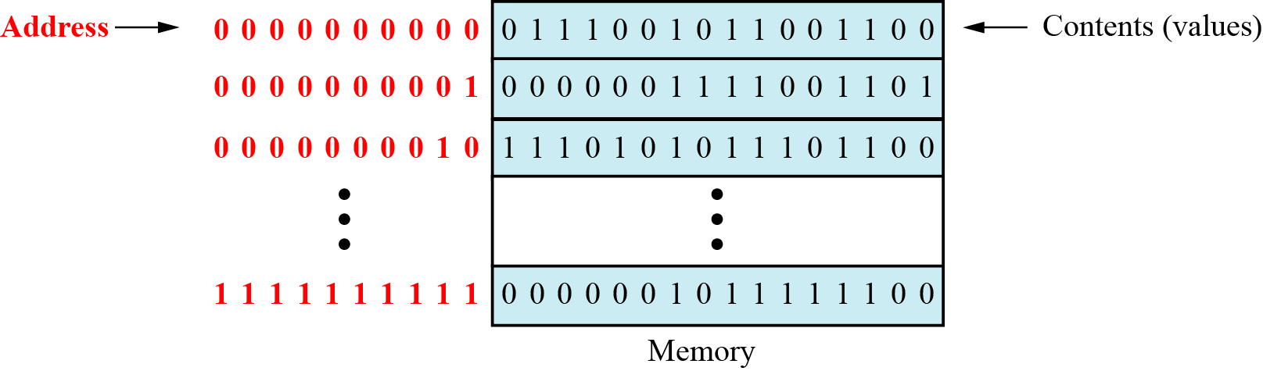
Memory Locations and Addresses

Slide 29
Address space
To access a word in memory requires an identifier. Although programmers use a name to identify a word (or a collection of words), at the hardware level each word is identified by an address.
The total number of uniquely identifiable locations in memory is called the address space.
For example, a memory with 64 kilobytes (16 address line required) and a word size of 1 byte has an address space that ranges from 0 to 65,535.

Slide 30
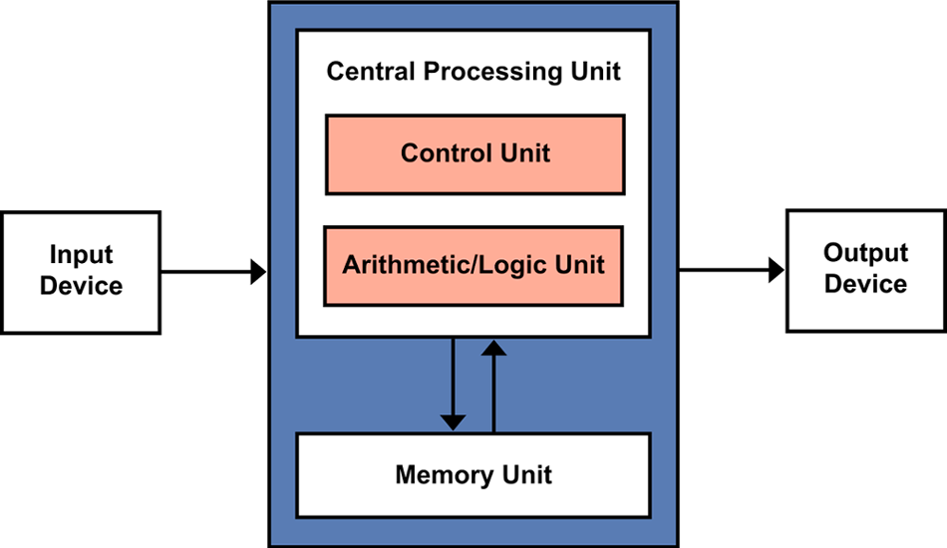
Computer Units

Slide 31
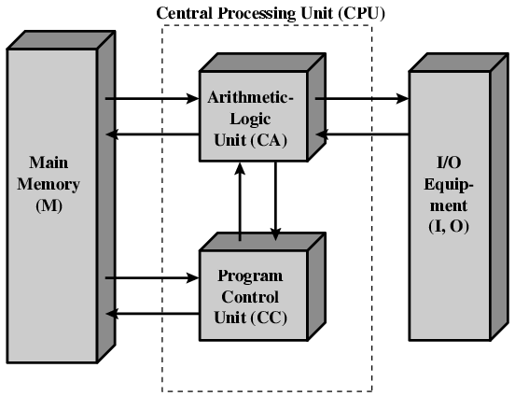
Von Neumann Machine
Historically there have been 2 types of Computers:
1. Fixed Program Computers – Their function is very specific and they couldn’t be programmed, e.g. Calculators. ADD AL,BL
2. Stored Program Computers – These can be programmed to carry out many different tasks, applications are stored on them, hence the name.
Von Neumann Machine is a general purpose computer with store program concept

Slide 32
Von Neumann Machine
The modern computers are based on a stored-program concept introduced by John Von Neumann. In this stored-program concept, programs and data are stored in a separate storage unit called memories and are treated the same.
Stored Program concept
Main memory storing programs (code) and data
ALU operating on binary data
Control unit interpreting instructions from memory and executing
Input and output equipment operated by control unit
It is also known as IAS computer:
Princeton Institute for Advanced Studies (IAS)
Completed 1952

Slide 33
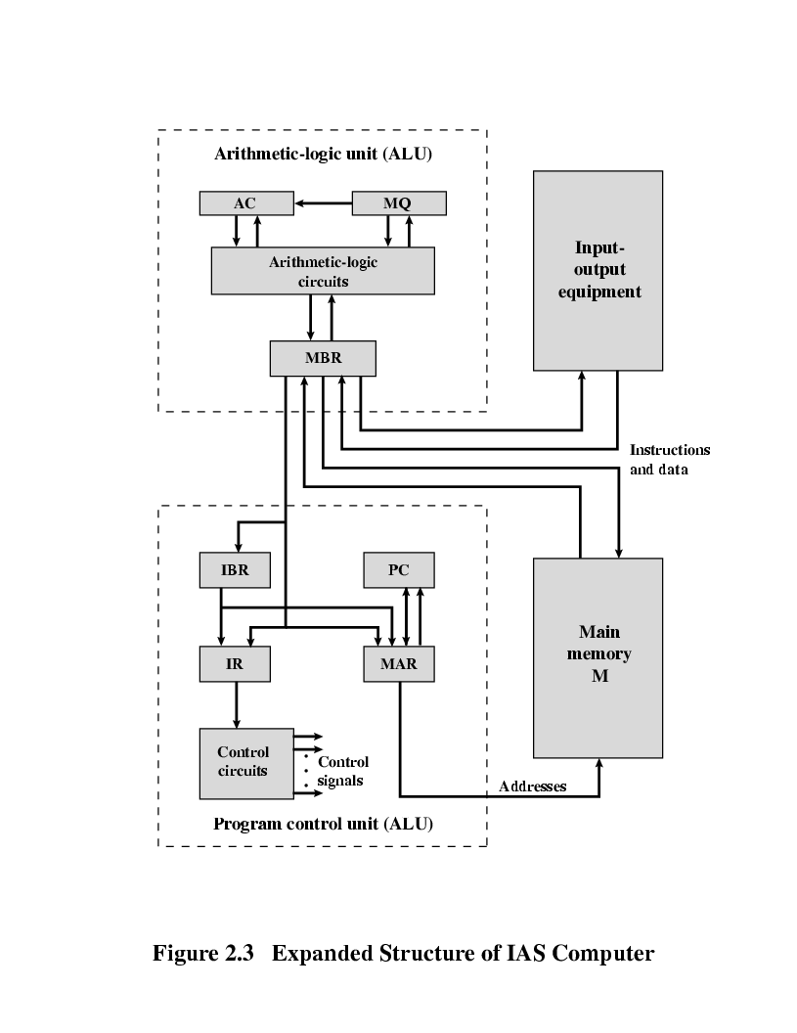
IAS Machine (Institute for Advanced Studies)

Slide 34
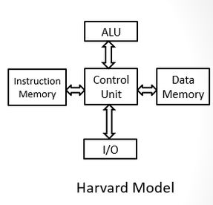
Harvard Architecture
Harvard Architecture introduce the separate memory concept.
Data and instruction memory blocks becomes separate entity.
Provides dedicated bus for connecting it.
Separate connection allows to access data and instruction simultaneously.
It overcomes the bottleneck of Von Neumann Machine with single memory block.

Slide 35
IAS Machine (Institute for Advanced Studies)
Memory buffer register (MBR):
Contains a word to be stored in memory or sent to the I/O unit, or is used to receive a word from memory or from the I/O unit.
Memory address register (MAR): 12 bits
Specifies the address in memory of the word to be written from or read into the MBR.
Instruction register (IR):
Contains the 8-bit opcode instruction being executed.
Instruction buffer register (IBR):
Holds temporarily the right hand instruction from a word in memory.
PC:
Connected to the internal address bus, the Program Counter holds the address in memory of the next program instruction. Notice that it doesn’t connect directly to the memory, but must go via the MAR.
Accumulator (AC) and Multiplier Quotient (MQ):
Hold temporary operands and result of ALU operation.
Ex. 40bit *40 bit=80 bit then AC=MSB (40 bit) and MQ=LSB (40 bit)

Slide 36

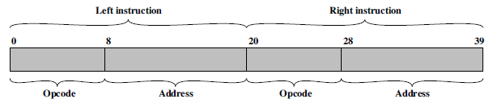
IAS Machine Instruction Format
Opcode is an instruction that tells processor what to do with the variable or data written besides it. Ex MOV: 8BH; LOAD:3AH; STOR:32H; ADD:86H
Oprand is a variable that stores data(and data can be a memory address or any data that we want to process).
e.g. MOV AL,BL
here instruction MOV is an opcode. AL & BL are oprands.
Instruction word
Opcode is processor’s Operational Code which is designed during the manufacturing of the chip. Which means you can not change the opcode unless you change the HARDWARE design of the processor.

Slide 37
IAS working Steps
Memory:
LOAD M(X) 500, ADD M(X) 501
STOR M(X) 500, (Other Instruction) 500=7
3
4
Ref:: https://www.youtube.com/watch?v=mVbxrQE4f90

Slide 38
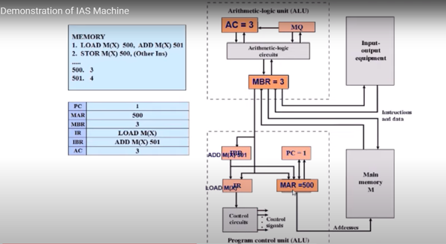
IAS working Steps
Memory:
1. LOAD M(X) 500, ADD M(X) 501
2. STOR M(X) 500, (Other Instruction)
3
4

Slide 39
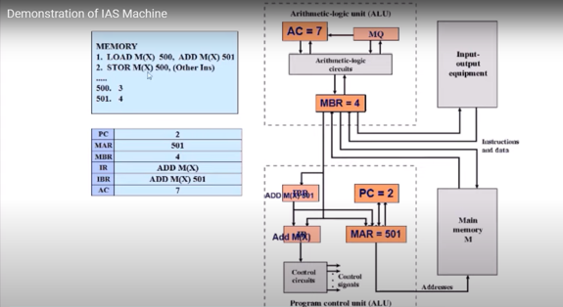
IAS working Steps
Memory:
1. LOAD M(X) 500, ADD M(X) 501
2. STOR M(X) 500, (Other Instruction)
3
4s

Slide 40
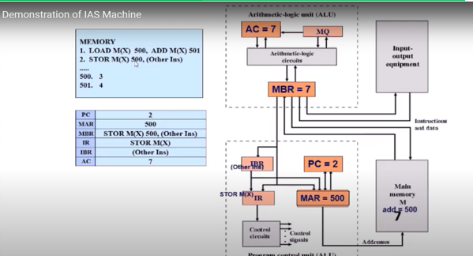
IAS working Steps
Memory:
2. STOR M(X) 500, (Other Instruction)
3
4

Slide 41
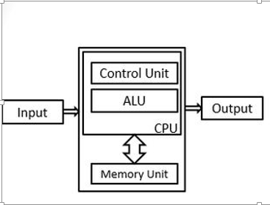
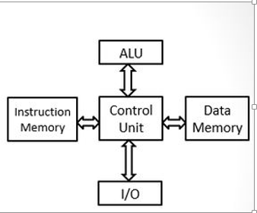
Von Neumann Architecture
Harvard Architecture

Slide 42
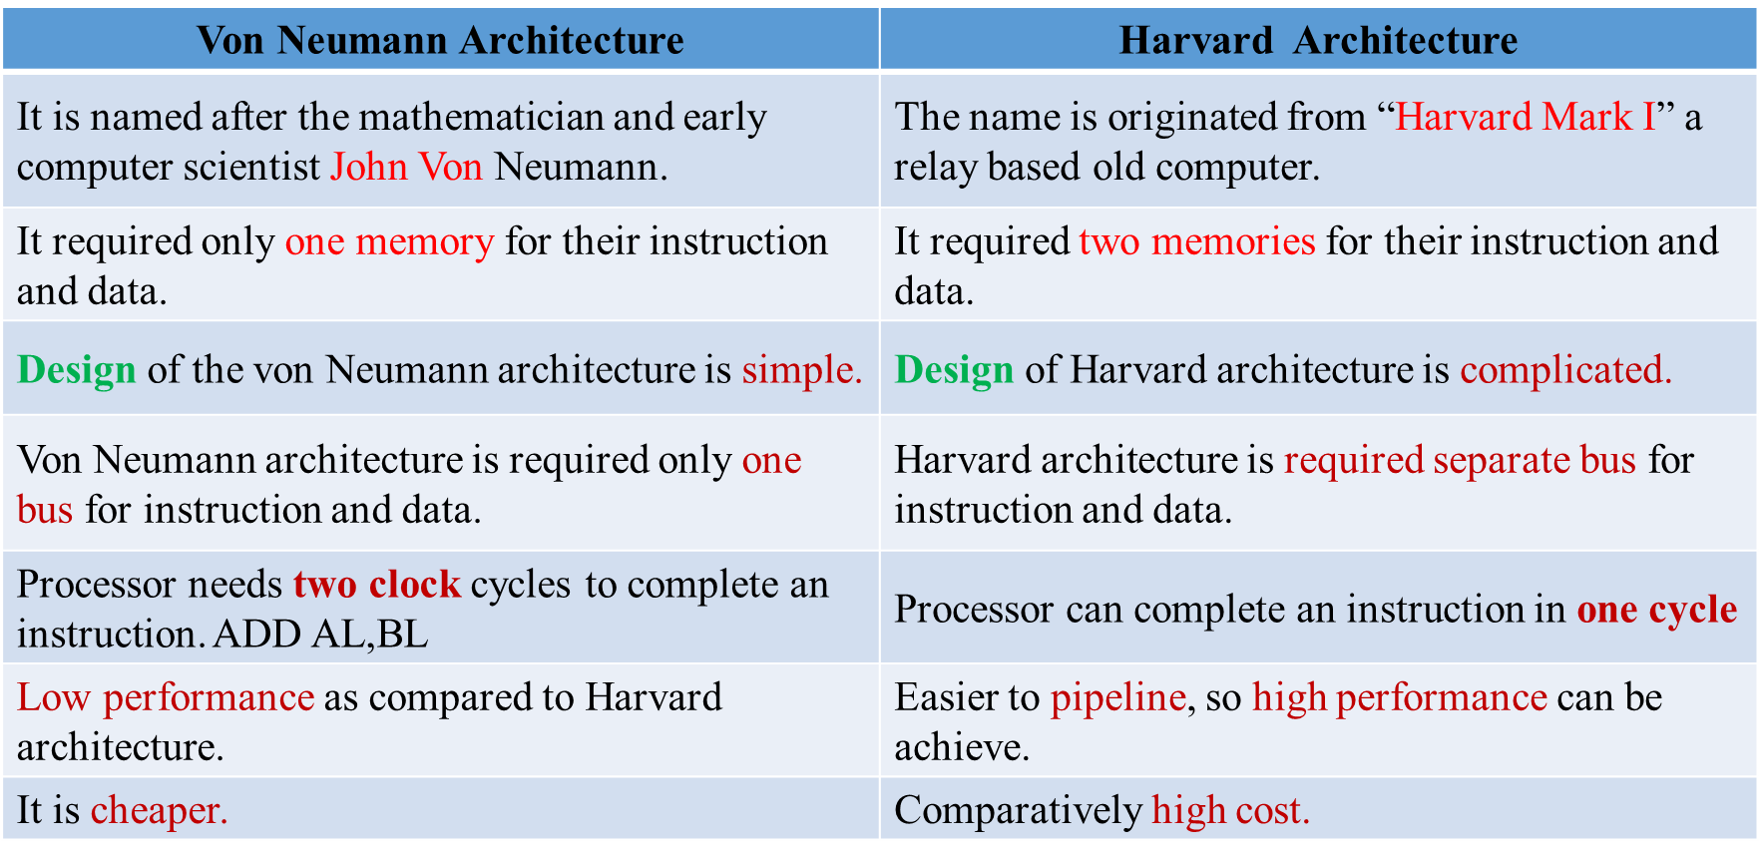
Comparison of Von Neumann and Harvard

Slide 43
RISC and CISC Machines
Reduced Instruction Set Architecture
Focus on hardware simplification
Uses basic instruction
Reduce the cycles per instruction at the cost of the number of instructions per program.
Complex Instruction Set Architecture
Try to perform functions like load, evaluate and store operation with single instruction. Example – Multiply command
Approach attempts to minimize the number of instructions per program but at the cost of an increase in the number of cycles per instruction.

Slide 44
RISC and CISC Machines
BASIS FOR COMPARISON | RISC (Reduced Instruction Set Computer) | CISC (Complex Instruction Set Computer)
Emphasis on | Software | Hardware
Includes | Single clock | Multi-clock
Instruction-set size | Small | Large
Instruction formats | fixed (32-bit) format | Varying formats (16-64 bits each instruction).
Addressing modes used | Limited to 3-5 | 12-24
General purpose registers used | 32-192 | 8-24 al bl, cl
Memory inferences | Register to register | Memory to memory
Cache design | Split data cache and instruction cache. | Unified cache for instructions and data.
Clock rate | 50-150 MHz | 33-50 MHz
CPU Control | Hardwired without control memory. | Microcoded using control memory (ROM).

Slide 45
RISC and CISC Machines
BASIS FOR COMPARISON | RISC (Reduced Instruction Set Computer) | CISC (Complex Instruction Set Computer)
Pipeline | High Pipelined | Not or less Pipelined
Data Transfer | Register to Register | Memory to Memory
Instruction refer to the Memory | Only load and store | All
Used in | Portable devices, Apple iPod, Smart phone, Tablets | Desktop, Laptops
Set of instructions | Highly optimized | Less optimized
RAM is required to store instruction | High | Very less
Instruction decoding logic | Simple | Complex
Program length | Large | Small
Example: Multiply 2 Numbers | LW A, 203 ;Load LW B, 502 ;Load MULT A,B SW 203,A ;Store | MULT 203,502

Slide 46
Arithmetic and Logical Unit

Slide 47
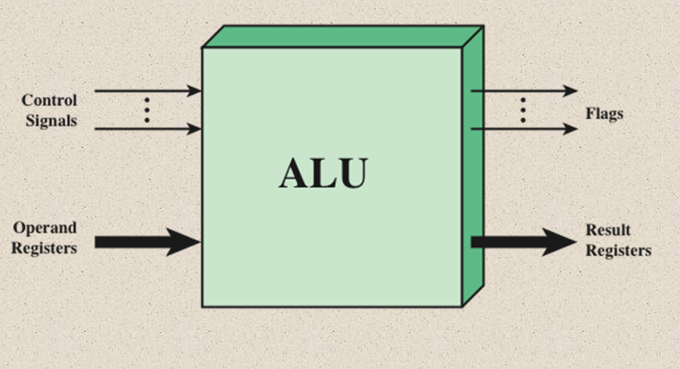
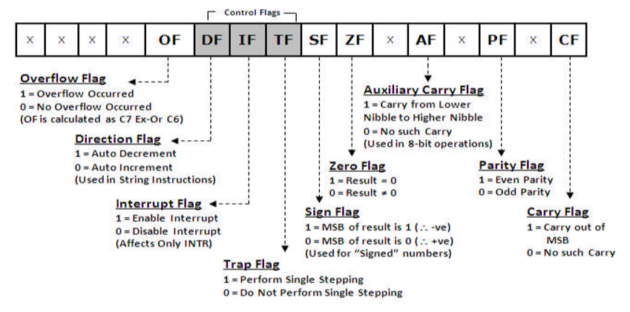
ALU Inputs and Outputs

Slide 48
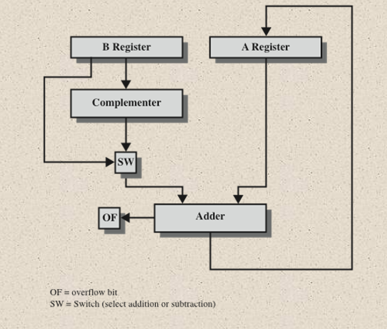
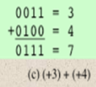

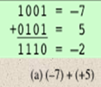
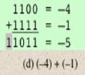
Block Diagram: Hardware for Addition and Subtraction

Slide 49
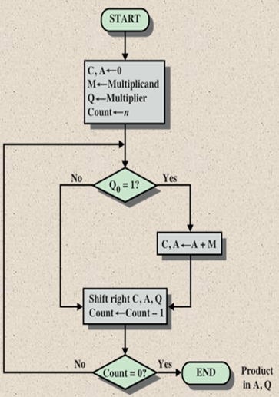
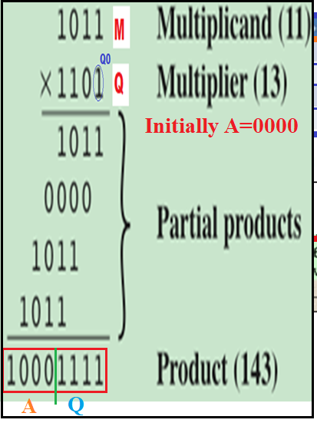
Multiplication (Unsigned Binary Integers 11*13=143)

Slide 50
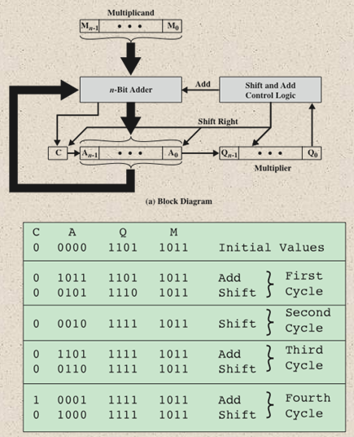
Hardware Implementation of Unsigned Binary Multiplication Operation

Slide 51
Booth’s Algorithm (Signed Number Multiplication)
Used to reduce number of operations
For signed multiplication
Generate 2n bit product
Treats positive and negative numbers uniformly (called 2s compliment method)
Recoding of Multiplier is performed
Rules of recording – Use implied zero at LSB and start scanning LSB to MSB
Rules for recoded number
0-1 | -1
1-0 | 1
0-0 | 0
1-1 | 0
1. 001110 0 = Recoded 0 1 0 0 -1 0
2. 101100 0 = Recorded -11 0 -1 0 0

Slide 52
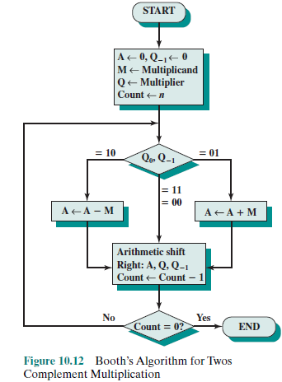
Booth’s Algorithm

Slide 53
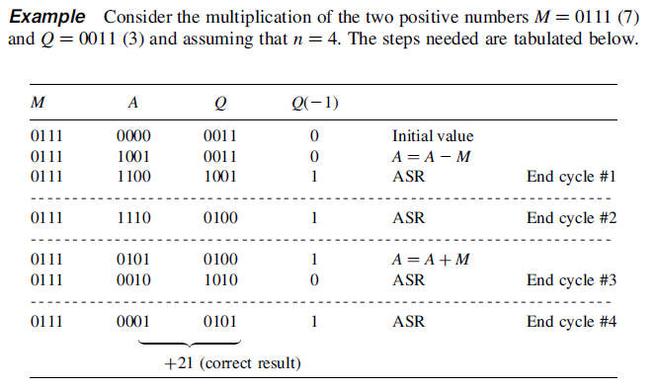
Booths Algorithm using Tabular Method.

Slide 54
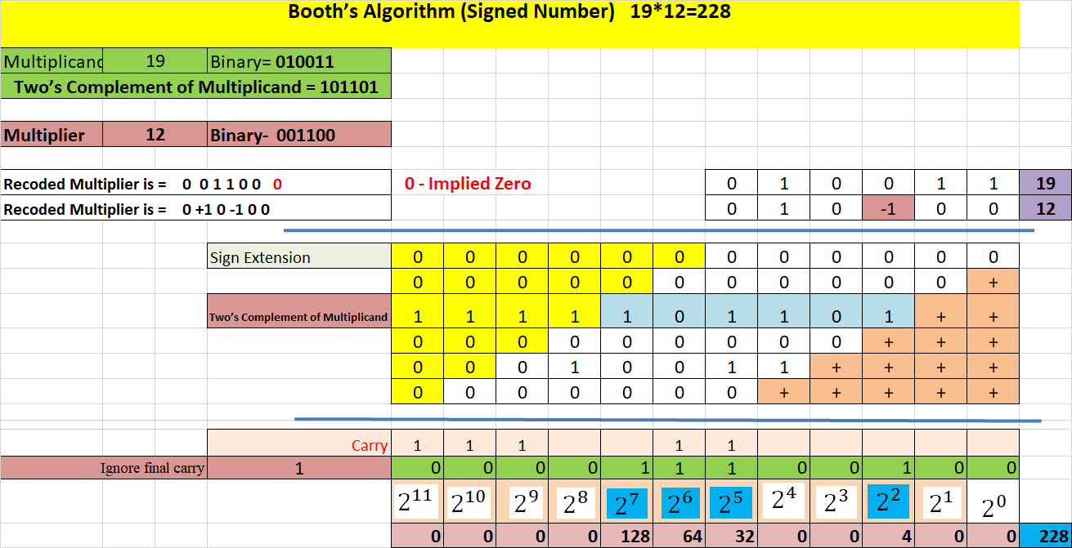
Booth’s Algorithm

Slide 55
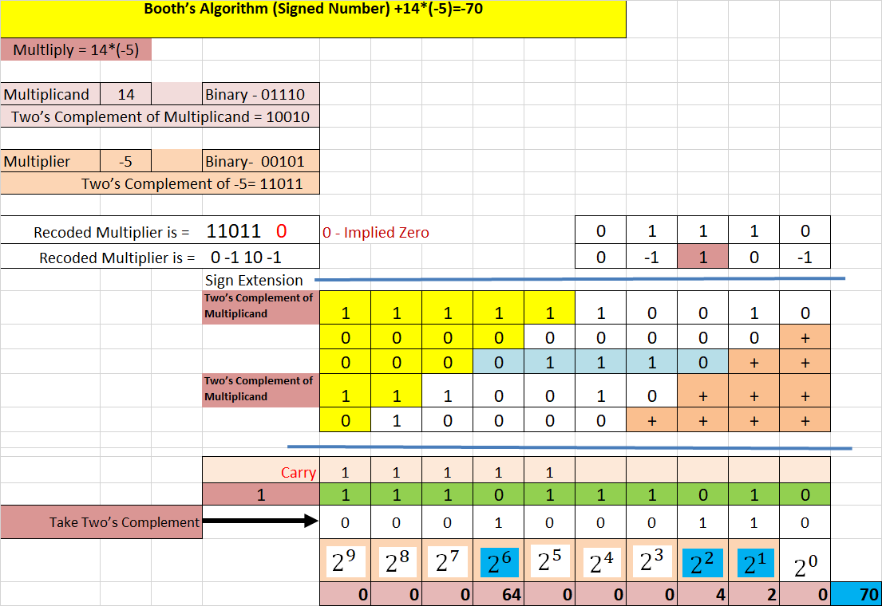
Booth’s Algorithm

Slide 56
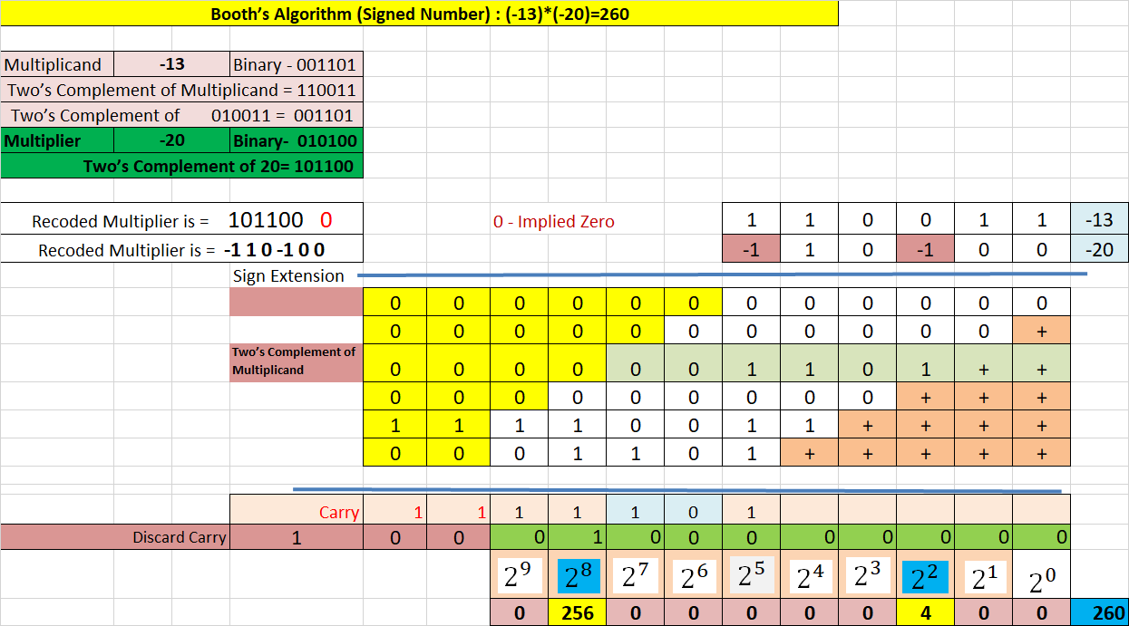
Booth’s Algorithm

Slide 57
Processor Organization

Slide 58
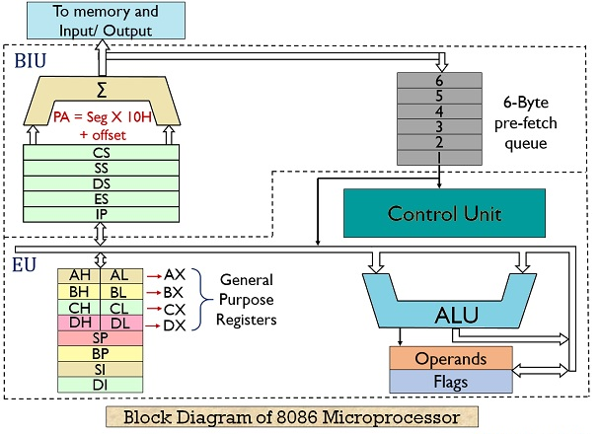
8086 Microprocessor

Slide 59
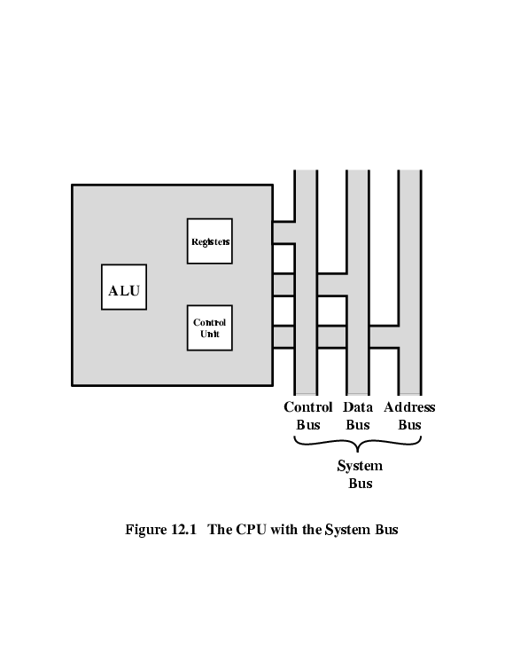
Processor Organization: CPU with System Bus
To understand the organization of the processor, let us consider the requirements placed on the processor, the things that it must do:
• Fetch instruction: The processor reads an instruction from memory (register, cache, main memory).
• Interpret instruction: The instruction is decoded to determine what action is required.
• Fetch data: The execution of an instruction may require reading data from memory or an I/O module.
• Process data: The execution of an instruction may require performing some arithmetic or logical operation on data.
• Write data: The results of an execution may require writing data to memory or an I/O module.

Slide 60
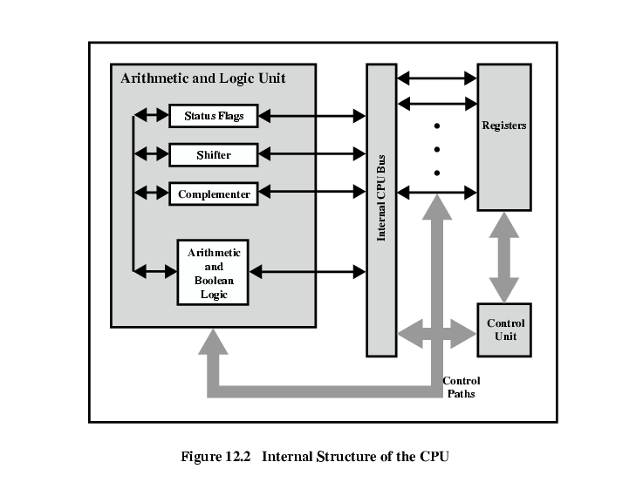
CPU Internal Structure

Slide 61
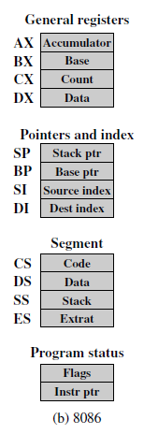
Register Organization
A computer system employs a memory hierarchy. At higher levels of the hierarchy, memory is faster, smaller, and more expensive (per bit).Within the processor, there is a set of registers that function as a level of memory above main memory and cache in the hierarchy. The registers in the processor perform two roles:
• User-visible registers: Enable the machine- or assembly language programmer to minimize main memory references by optimizing use of registers.
• Control and status registers: Used by the control unit to control the operation of the processor and by privileged, operating system programs to control the execution of programs.

Slide 62
Register Organization
User-visible registers: General Purpose , Segment Registers, Index Pointers and Stack Pointer , Condition Codes (Flag Register)
2. Control and status registers (Not Visible to user):
Program Counter (PC)
Instruction Decoding Register (IR)
Memory Address Register (MAR)
Memory PSW (Program Status Word)
Buffer Register (MBR)
Condition Codes + other status information
The current state of processor is stored in a register called Processor Status Word (PSW).
Six are status flags and three are control flags.

Slide 63
Instruction Cycle
Fetch
Interrupt
Indirect
Execute
an instruction cycle includes the following stages:
• Fetch: Read the next instruction from memory into the processor.
• Execute: Interpret the opcode and perform the indicated operation.
• Interrupt: If interrupts are enabled and an interrupt has occurred, save the current process state and service the interrupt.
The Indirect Cycle: if indirect addressing is used, then additional memory accesses are required.

Slide 64
Instruction Cycle
It is the time in which a single instruction is fetched from memory, decoded, and executed.
An Instruction Cycle requires the following sub cycle:
Fetch : Read next instruction from memory into the processor
Indirect Cycle (Decode Cycle): May require memory access to fetch operands, therefore more memory accesses.
Interrupt: Save current instruction and service the interrupt 256 (int 0-int 255) 20=1MB=256*4 CS 2 IP 2 IVT 00000 FFFFFH
Execute: Interpret the opcode and perform the indicated operation

Slide 65
Indirect Cycle
May require memory access to fetch operands.
Indirect addressing requires more memory accesses.
Can be thought of as additional instruction sub cycle.
Fetch
Interrupt
Indirect
Execute

Slide 66
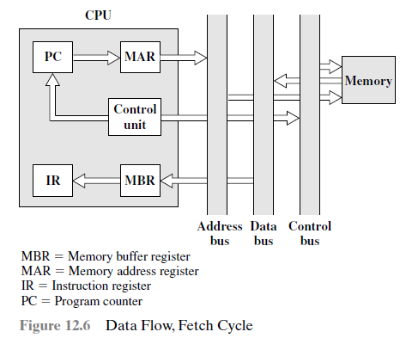
Data Flow
The exact sequence of events during an instruction cycle depends on the design of the processor. Here indicate in general terms what must happen.
Let us assume that a processor that employs a memory address register (MAR),
a memory buffer register (MBR), a program counter (PC), and an instruction register (IR).
During the fetch cycle, an instruction is read from memory. As shown in fig.
The flow of data during this cycle. The PC contains the address of the next instruction to be fetched. This address is moved to the MAR and placed on the address bus.
The control unit requests a memory read, and the result is placed on the data bus and copied into the MBR and then moved to the IR. Meanwhile, the PC is incremented by 1, preparatory for the next fetch.

Slide 67
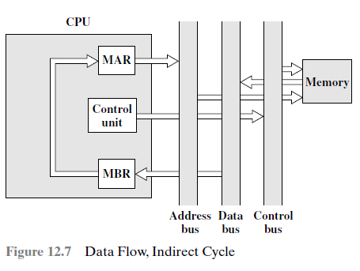
Data Flow
Once the fetch cycle is over, the control unit examines the contents of the IR to determine if it contains an operand specifier using indirect addressing. If so, an indirect cycle is performed. As shown in Figure, this is a simple cycle. The rightmost
N bits of the MBR, which contain the address reference, are transferred to the MAR. Then the control unit requests a memory read, to get the desired address of the operand into the MBR.
The fetch and indirect cycles are simple and predictable.
The execute cycle takes many forms; the form depends on which of the various machine instructions is in the IR. This cycle may involve transferring data among registers, read or write from memory or I/O, and/or the invocation of the ALU.

Slide 68
Addressing Modes

Slide 69
Why Addressing Modes?
An addressing mode specifies how to calculate the effective memory address of an operand by using information held in registers and/or constants contained within a machine instruction.
Ex. Immediate addressing Mode:
MOV DL, 08H
MOV CX, 4929 H

Slide 70
Addressing Modes
Register Addressing
Immediate Addressing
-----------------------------------------------------------------------------------------
Direct Addressing
Register Indirect Addressing
Based Addressing
Indexed Addressing
Based Index Addressing
String Addressing
-----------------------------------------------------------------------------------------
Direct I/O port Addressing
10. Indirect I/O port Addressing
-----------------------------------------------------------------------------------------
11. Relative Addressing
-----------------------------------------------------------------------------------------
12. Implied Addressing
Group I : Addressing modes for register and immediate data
Group II : Addressing modes for memory data
Group III : Addressing modes for I/O ports
Group IV : Relative Addressing mode
Group V : Implied Addressing mode

Slide 71
Pipelining

Slide 72
What is Pipelining?
Laundry Example
Washer takes 30 minutes
Dryer takes 40 minutes
Folder takes 20 minutes
A
B
C
D
Wash 30 min
Dry 40 min
fold 20 min
Total= 1Hr 30 min / 90 min

Slide 73
What is Pipelining?
6 PM
7
8
9
10
11
Midnight
Time
30
40
20
30
40
20
30
40
20
30
40
20
T
a
s
k
O
r
d
e
r
A
wash, dry, and fold
B
wash, dry, and fold
C
wash, dry, and fold
D
wash, dry, and fold
Sequential laundry takes 6 hours for 4 loads (90 min+90 min + 90 min + 90 min= 360 Min)
If they learned pipelining, how long would laundry take?

Slide 74
What is Pipelining ?
6 PM
7
8
9
10
11
Midnight
Time
30
40
40
40
40
20
T
a
s
k
O
r
d
e
r
A
Pipelined laundry takes 3.5 hours (210 min) for 4 loads
wash, dry, and fold
B
Without Pipelined laundry takes 6 hours (360 min) for 4 loads
C
D

Slide 75
Instruction Pipelining
Instruction processing is subdivided:
Fetch and Execute instruction
1st Stage – Fetch an instruction and buffers it.
2nd Stage–Temporarily free until first stage passes it the buffered instruction.
While the second stage is executing the instruction, the first stage fetches and buffers the next instruction.
Instruction prefetch or fetch overlap.
Purpose?🡪 To speed up instruction execution.

Slide 76
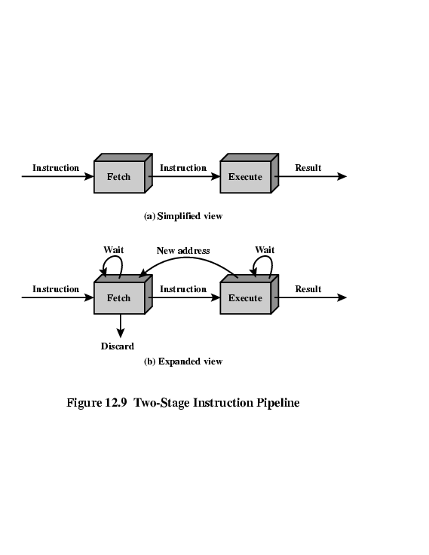
Two-Stage Instruction Pipeline (8086)

Slide 77
Instruction Processing
Fetch instruction (FI)
Decode instruction (DI)
Calculate operands (CO)
Fetch operands (FO)
Execute instruction (EI)
Write operand (WO)
Successive instructions in a program sequence will overlap in execution.

Slide 78
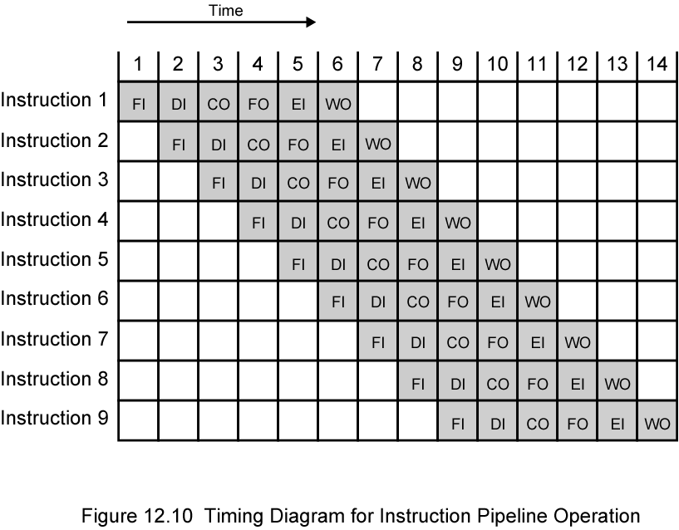
Timing Diagram for Instruction Pipeline Operation
Fetch instruction (FI)
Decode instruction (DI)
Calculate operands (CO)
Fetch operands (FO)
Execute instruction (EI)
Write operand (WO)
14 clk
6*9=54

Slide 79
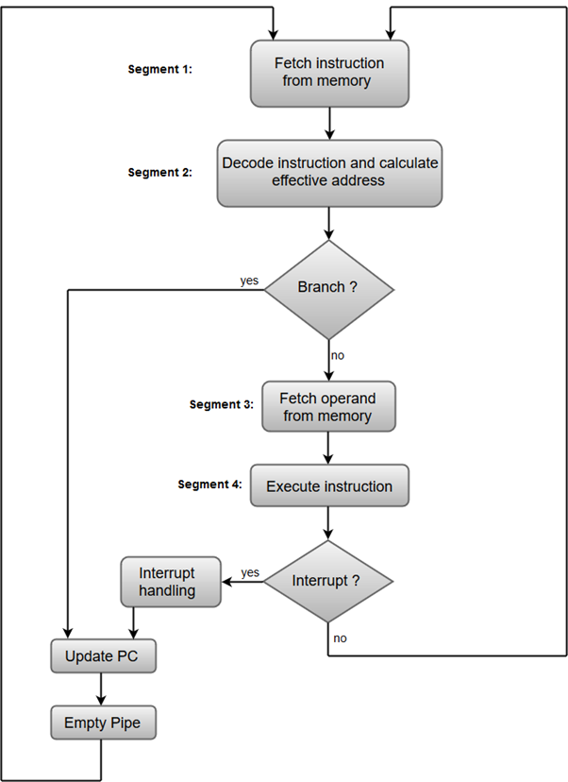
Instruction Pipeline
FI: Fetch instruction
DI: Decode instruction
CO: Calculate operands
FO: Fetch operands
EI: Execute instruction
WO: Write operan
MOV AL,BL
JNZ 1000h
I15 1000:SUB BL,CL
1500 JZ 2000
2000: ADD AL,BL

Slide 80
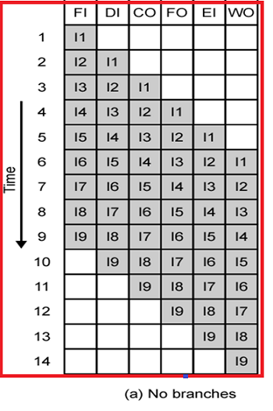
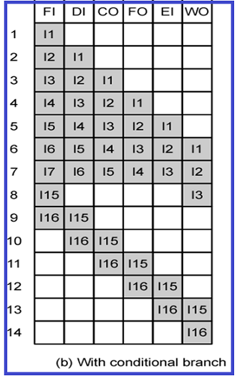
Alternative Pipeline description

Slide 81
Pipeline Hazards
Pipeline hazards are situations that prevent the next instruction in the instruction stream from executing during its designated clock cycles.
Any condition that causes a stall in the pipeline operations can be called a hazard.
In the design of pipelined computer processors, a pipeline stall is a delay in execution of an instruction in order to resolve a hazard.
Structural Hazard
Data Hazard
Control Hazard

Slide 82
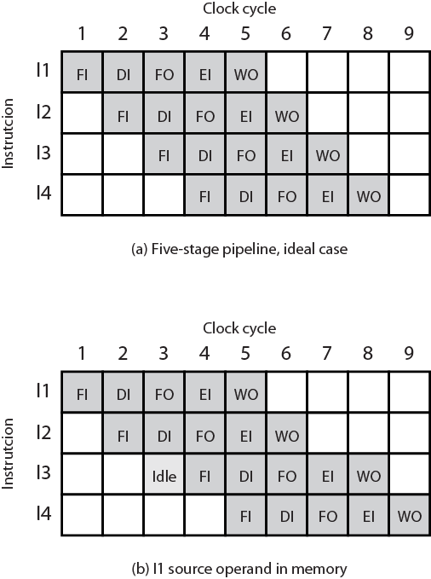
Structural Hazard
Resource (Structural) Hazards - Two (or more) instructions in pipeline need same resource. Executed in serial rather than parallel for part of pipeline Also called structural hazard

Slide 83

Data Hazard
Read after Write (RAW), or true dependency
-An instruction modifies a register or memory location
-Succeeding instruction reads data in that location
-Hazard if read takes place before write complete
Write after Read (WAR), or antidependency
-An instruction reads a register or memory location
-Succeeding instruction writes to location
-Hazard if write completes before read takes place
Write after Write (WAW), or output dependency
-Two instructions both write to same location
-Hazard if writes take place in reverse of order intended sequence.
MUL BX,AX
SUB AX, CX

Slide 84
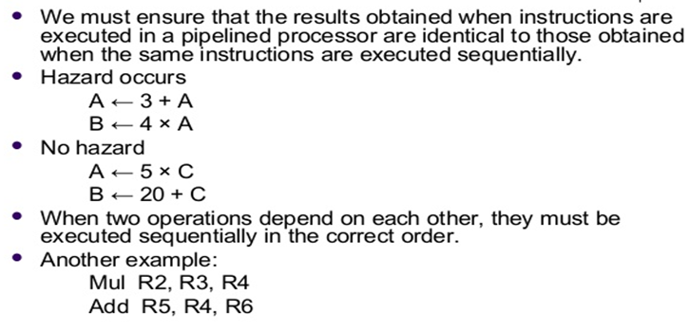
Data Hazard

Slide 85
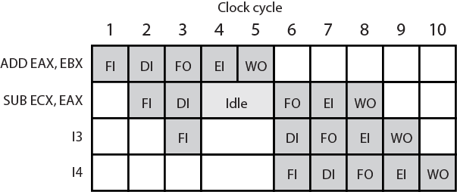
Data Hazard Diagram
Conflict in access of an operand location
Two instructions to be executed in sequence
Both access a particular memory or register operand
If in strict sequence, no problem occurs

Slide 86
Control Hazard (Branch Hazard)
Pipeline makes wrong decision on branch prediction.
Brings instructions into pipeline that must subsequently be discarded (CALL, JUMP, LOOP, JC, JNC etc)
Dealing with Branches
-Multiple Streams
-Prefetch Branch Target
-Loop Buffer
-Branch Prediction
-Delayed Branching

